Slide 1

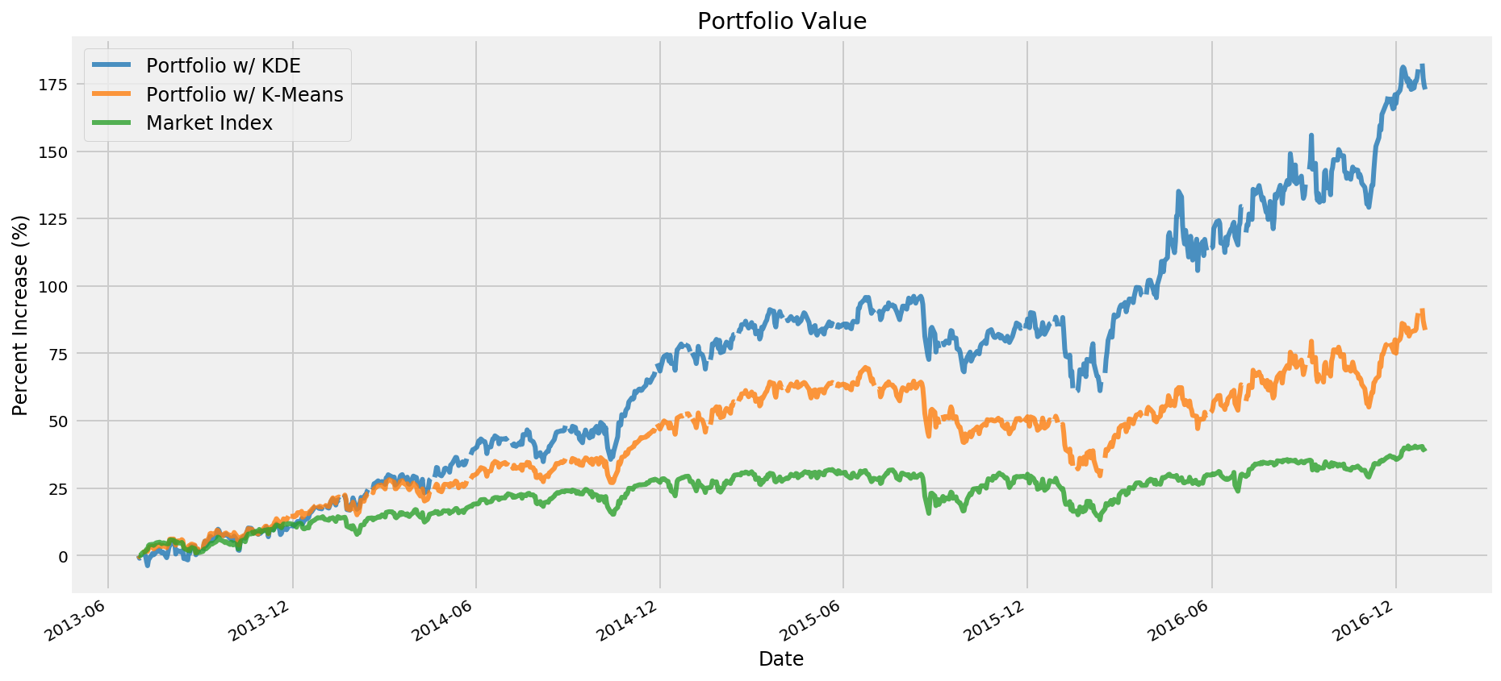

Stock Portfolio Optimization
Cole Reynolds, Sahil Patel, Neal Vaghasia
Abstract
The potential ramifications of applying data analytics to the study of the stock market are enormous and could change the way people invest forever. In this project, we will use data analytics to construct an optimal asset portfolio consisting of stocks in the S&P 500 (the 500 largest companies in the United States). We do this through two different clustering techniques, Kernel Density Estimation and K-Means, to identify the top performing stocks based on their Sharpe Ratios (a metric that compares returns to risk). We determine the effectiveness of our two portfolios by comparing them to the index fund SPY (an approximation for the stock market as a whole). We find that the KDE portfolio is significantly the best, followed by the K-Means portfolio, then SPY. The KDE portfolio showed a 173% return, the K-Means portfolio returned 84%, and SPY returned 39%.
Materials and Methods
Data
The daily closing price of every stock on the S&P 500 from April 1, 2013 to December 30, 2016
No noise – stock prices are a known value reported by the exchange
851264 observations x 7 variables (high, low, open, close, volume, ticker, date)
Predictor: The Sharpe Ratio
Numerical value that quantifies the performance of a stock over a time period
Calculated by comparing percentage returns to variance
$$∆price= \frac{{price}_{end}−{price}_{start}}{\# days}$$
$$RSS= \sum_{i=0}^{n}{{[{price}_{i}−\left(∆price×i\right)]}^{2}}$$
$$SR= \frac{(\frac{{price}_{end} − {price}_{start}}{{price}_{start}} ×100)−2}{RSS}$$
Method
Split data temporally into 3-month quarters
Roll through the quarters, using each quarter as training data for the clustering models to predict the optimal portfolio for the next quarter
Compare results of the two portfolios w/different clustering models to a standard market tracking index fund
Models
Kernel Density Estimation
Split data at local minima in the distribution
Any stock with Sharpe Ratio > 4th largest minima included in portfolio
K-Means
group data around the nearest means
4 clusters
Results
Performance
Portfolio determined by KDE increased in value by 173%
Portfolio determined by K-Means increased in value by 84%
Market index SPY increased in value by 39%
Average Portfolio Size
KDE Portfolio: 10 stocks
K-Means Portfolio: 29 stocks
Introduction
The market is full of uncertainty and predicting its performance is a difficult task. Most investors use the Market Portfolio Theory, which uses the Sharpe Ratio(a ratio between volatility (proxy for risk) and a stock’s past returns). Stocks with a high Sharpe Ratio tend to have better returns with lower risk. Using MPT as our basis, our project aims to create an optimal stock portfolio which minimize risk and maximizes returns. By using Kernel Density Estimation and K-Means clustering, we aim to predict which stocks to invest in quarterly based on their Sharpe Ratios. Our data set takes the opening and closing values of the top 500 companies in the United States stock market spanning from April 1st, 2013 to December 30th 2016.
Conclusion
Takeaway
It is possible to generate a stock portfolio that beats the general market by minimizing risk and maximizing potential returns
Contribution
Amateur investors can now invest with more peace of mind
Next steps
Add in cash filter to prevent major losses during market contractions
References: https://www.kaggle.com/camnugent/sandp500

